Slide 1
Who Needs a TV and a VCR?
SoftVCR for Windows
Myles MacRae
MEng ISE 4
Supervisor: Ian Harries

Slide 2
Presentation Goals
Overview of Technologies
Design Decisions
SoftVCR for Windows – Implementation
Evaluation
Summary
Questions
Demonstration in 203
Notes:
Questions will be taken down in the labs

Slide 3
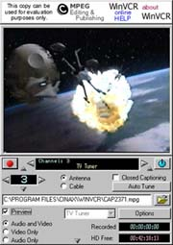
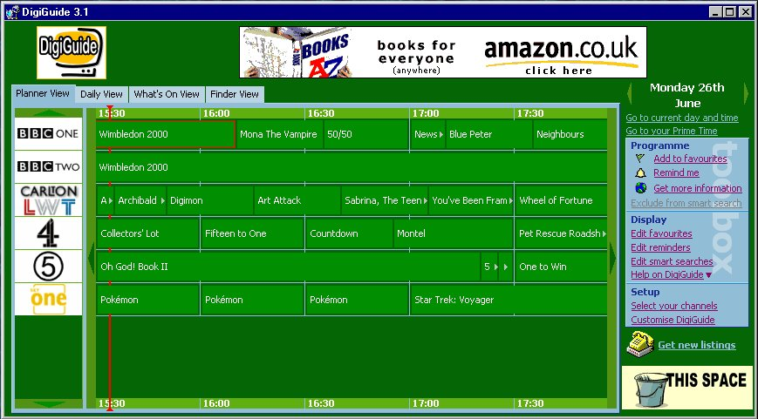
Current Applications
VCR Applications
  Cinax WinVCR
  MGI Pure DIVA
TV Listings
  Digiguide
  Websites
    BBC Radio Times
    Cable Guide
    Teletext
WinVCR
Digiguide
Notes:
Maybe split this up so I can give screen shots of the apps.

Slide 4
Available Technologies
Video Capture Frameworks under Windows
  Video For Windows 32bit
  Direct Show
Compression Codecs
  Intel Indeo 5.1
  Windows Media
  RealMedia

Slide 5
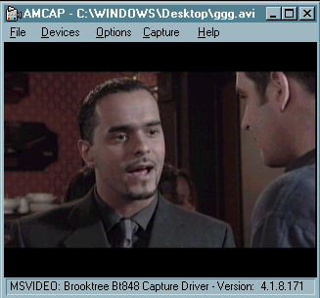
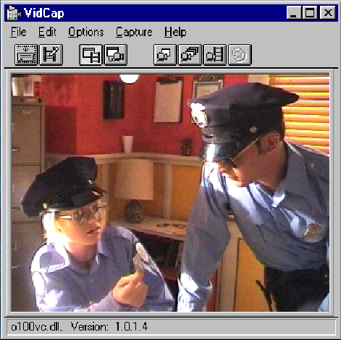
Design Decisions
Which Base Application?
AMCap
(DirectShow)
VidCap
(VFW)
Which Codec To Use?

Slide 6
SoftVCR for Windows V1.1
Built up of 4 separate modules:
  SoftVCR
    The main executable and capture program.
    Built on VidCap32
  VidLibrary
    DLL containing the Video Library
  TimerGuide
    DLL containing the Electronic Programme Guide and Recording Timer
  Playback
    DLL containing a simple playback interface to Windows Media Player
Notes:
Emphasize and explain the DLL architecture. Maybe describe some of the interfaces to the DLLs

Slide 7
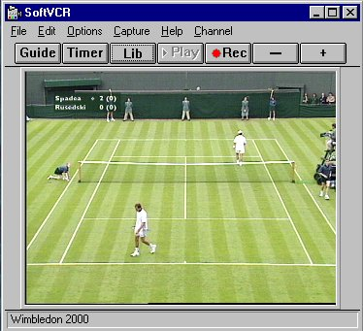
Changes made to VidCap
Inclusion of support for the Hauppauge WinTV tuner card
  Enabling and disabling sound
  Changing channels
  Also switching to the composite input
Simplifying the interface
  One Button Record
  Changing the menus and toolbars

Slide 8
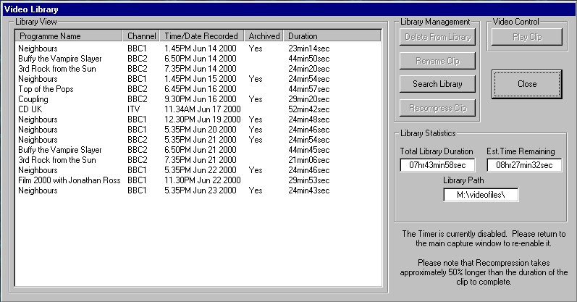
The Video Library
Allows complete management of recorded videos.
  Renaming
  Deleting
  Viewing
  Recompression
Notes:
I want to describe what the video library allows me to do..

Slide 9
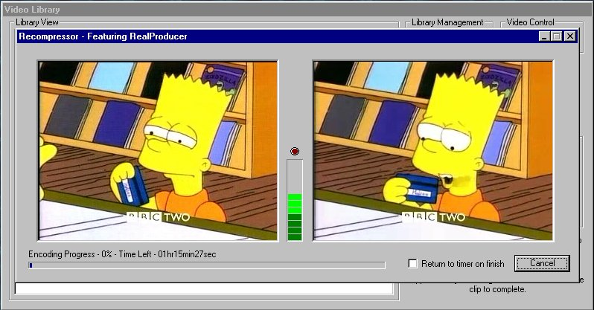
Recompression
For archiving videos
Uses Real Networks’ RealProducer ActiveX control.
Encodes using the new V8.0 codec. Better quality video.
Saving of 85% over original AVI file.

Slide 10
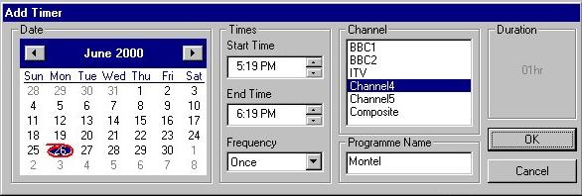
Timer
Adding a Timer
  Manually
  Via EPG
It will detect collisions with entries already in list
Offers ability to set repeat recordings for the same program:
  Once, Daily, Weekly, Week days, Weekends.

Slide 11
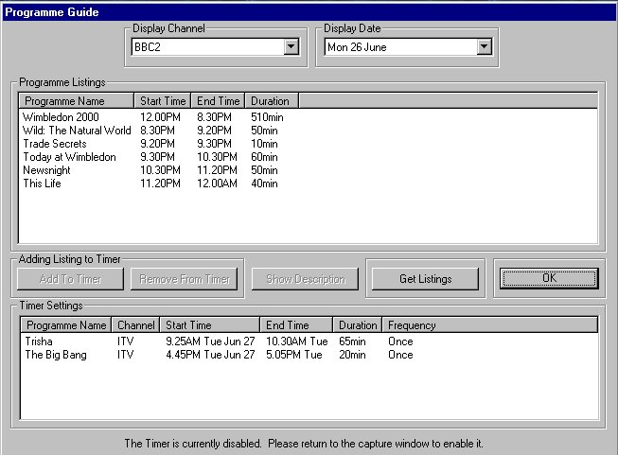
Electronic Programme Guide
Offers a simple means to browse television listings and create timer events
Listings are gathered from Internet Websites
  BBC Radio Times
  Cable Guide
A single parser is able to read any website through external configuration files

Slide 12
Parsing the Web
2 components of a web parser
  Constructing a URL
  Extracting information from the returned page
SoftVCR uses a Finite State Machine design to extract information.
  States can indicate the current position in a page
  Triggers are HTML tags
  Actions can be extraction, termination or null
NotInTable
Trigger:
<TABLE>
Trigger:
<\TABLE>
InTable
Notes:
FSM used because it is unnecessary to parse and understand everything on the page. We are only interested in times, programme naems and descriptions in this program.

Slide 13
Listing Parser Format - LPF
Describes a parser in a simple text format
Made up of sections:
  <CHANNEL> - A list of all television channels available on the source
  <URL> - A list containing the components needed for constructing a URL.
  <STATETABLE> - A collection of states, describing the FSM.
A state is made up of:
  STATE:
  NEXTSTATE:
  TRIGGER:
  ACTION:
Additionally:
  SEARCHSTRING:
  ATTRIBUTE:
  …if Action is not null.

Slide 14
Summary
Evaluation
  Mainly favourable.
  Suggestions of enhancements to interface.
  Further use of programme information
Achievements
  No other product at present uses a web parser for providing listings
  Using Indeo 5.11 gives good VCR quality on a modest platform at a low bitrate.
Future Enhancements
  Move to DirectShow or Windows Media architecture

